Slide 1
The power of words: Six-word memoirs
Guiding question: How can you tell your life story in six words?
Objective: Demonstrate understanding of how the words we use are important.
Language objectives: Write a six-word memoir using words with the appropriate CONNOTATION, REGISTER, and SOUND/RHYTHYM.

Slide 2
Six-Word Memoirs: A brief history
Baby shoes: For sale; never worn.
--Ernest Hemingway
https://www.youtube.com/watch?v=0ZOxhHXZW6o

Slide 3
Target vocabulary for today’s learning opportunity
Connotation: the emotional or personal associations the word carries, beyond its literal definition
Ex: child, kid, tyke, juvenile, youngster, adolescent
Register: the level of formality or informality associated with the word
Ex: Speak, chat, verbalize, orate, converse, yak, communicate, discuss
Sound and rhythm: the way words sound and scan contribute to their appropriateness

Slide 4
Group Brainstorm
What is your group’s definition of a synonym?
We will use this discussion to talk about how and author or poet may look for the “best word” for their writing when several are available.
“Any word you have to hunt for in a thesaurus is the wrong word. There are no exceptions to this rule.”
― Stephen King

Slide 5
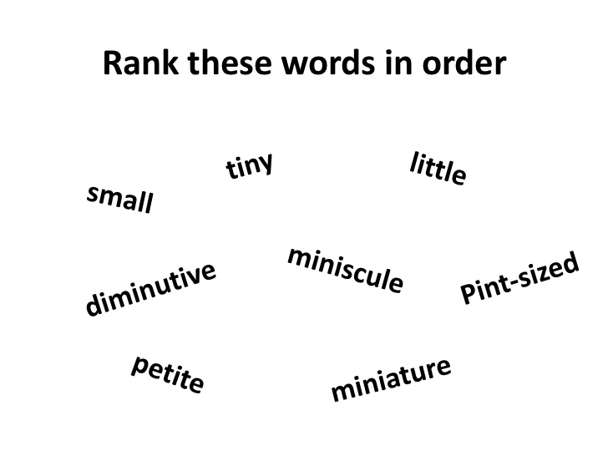
Connecting to connotation

Slide 6
What are the different connotations of these words?

Slide 7
In your color groups, discuss the following:
What is a synonym and why are they important in writing?
What’s the difference between a story and a memoir?
Why do we tell stories?
Who knows your story best?
How is it both possible and impossible to convey (show) the essence of who you are in six words?

Slide 8
Discuss the sample memoirs (Choose 2-3 questions).
After reading all the six-word memoirs, what surprises you about this form? What can you learn from it to take to other types of writing?
In your mind what were the most common themes in the collection?
Pick one of the memoirs that you do not understand and discuss what it might mean with your classmates.
Which of these memoirs is the most poignant to you and why? Which is the most tragic and why?
Which is the funniest and why?
What do you make of the word “still” in Georgene Nunn’s memoir?

Slide 9
Dr. Pelotte’s six-word memoirs.
To Arizona, then Chicago. Back again.
Four cats; no plans to stop.
From the stage to the classroom.
It is my honor to teach.
People like me don’t get PhDs.
Must keep my memoir school appropriate.

Slide 10
Your turn:
Craft your own six word memoirs:
You can use the six fun facts you wrote down at the beginning of class (but this is not a requirement.)
Choose words that have a specific CONNOTATION, REGISTER, or SOUND/RHYTHYM to them.
Ideas to get you started: Your best memory, your worst memory, your proudest moment, your most embarrassing moment, an important life lesson you learned, an important person in your life…
Most importantly, have fun and make sure the memoirs tell a story about YOU!
Use your template provided to write 10-15 memoirs.

Slide 11
Sharing out
Share 2-3 of your six-word memoirs you wrote with your group.

Slide 12
Revising
Choose 3 of your OWN memoirs you wish to revise for connotation, register, and sound/rhythm.

Slide 13
Homework
Sketch out three (3) of your six-word memoirs for homework in the space provided.
Bring your brainstorm sketches with you tomorrow.

Slide 14
Question out the door day 1:
Share one thing I need to know about you.

Slide 15
Day 2: The power of language with six words.
Choose three memoirs your think you may want to illustrate. Sketch them out on the template provided.
Rewrite it replacing words for SPECIFIC connotation and register.
Connotation=emotional association (+ or -)
Register=informal/formal

Slide 16
Six Word Memoirs Day 3: The power of language with six words.
Let’s review vocabulary.
Denotation:
Connotation:
Register:

Slide 17
Six Word Memoirs Day 3: The power of language with six words.
Let’s review vocabulary.
Denotation: The dictionary (literal) definition of a word.
Connotation: The feelings, emotions, and associations of a word.
Register: formal/informal

Slide 18
Six Word Memoirs Day 3: The power of language with six words.
Take out the 3 memoirs you sketched out for homework.
You should have at least 2 version of EACH memoir—having replaced/altered words for SPECIFIC connotation and register. Each memoir must still contain six words.
Ex: Try taking a humorous memoir and adding a layer of frustration, longing, etc. Or take a series memoir and add a layer of humor.
Connotation= emotional association (+ or -)
Register= informal/formal

Slide 19
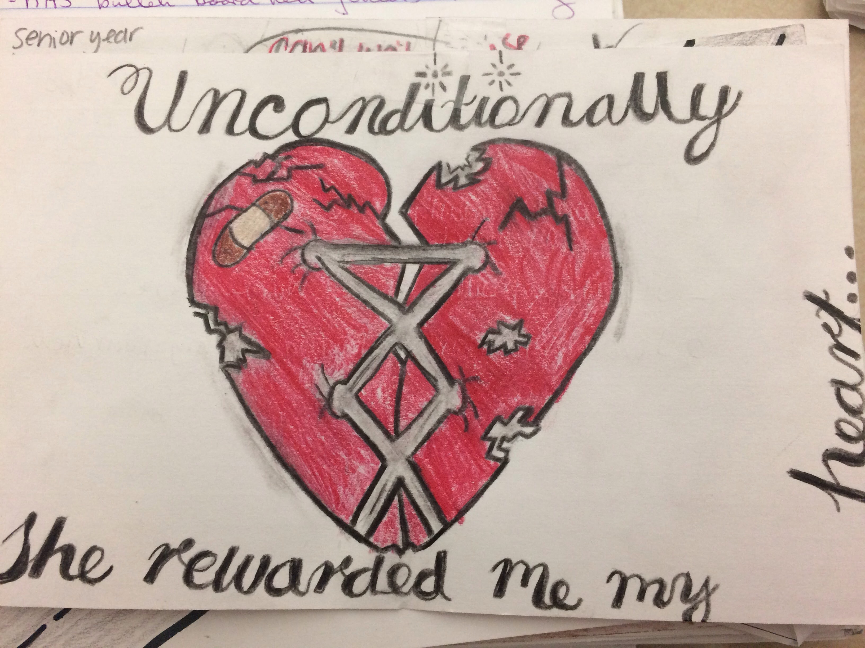

Slide 20
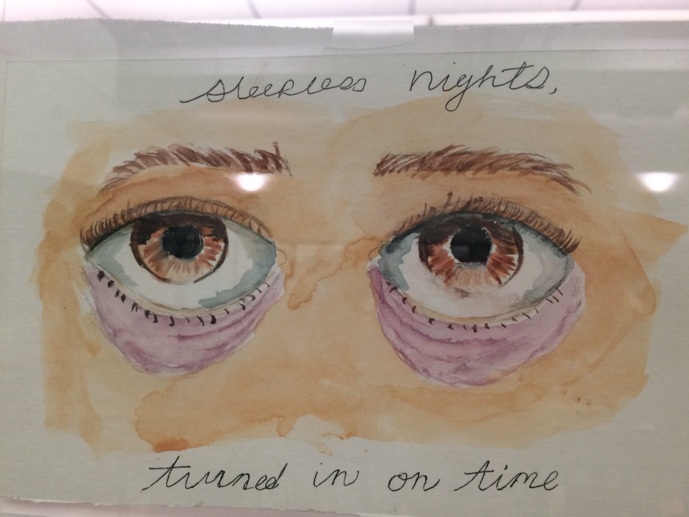

Slide 21
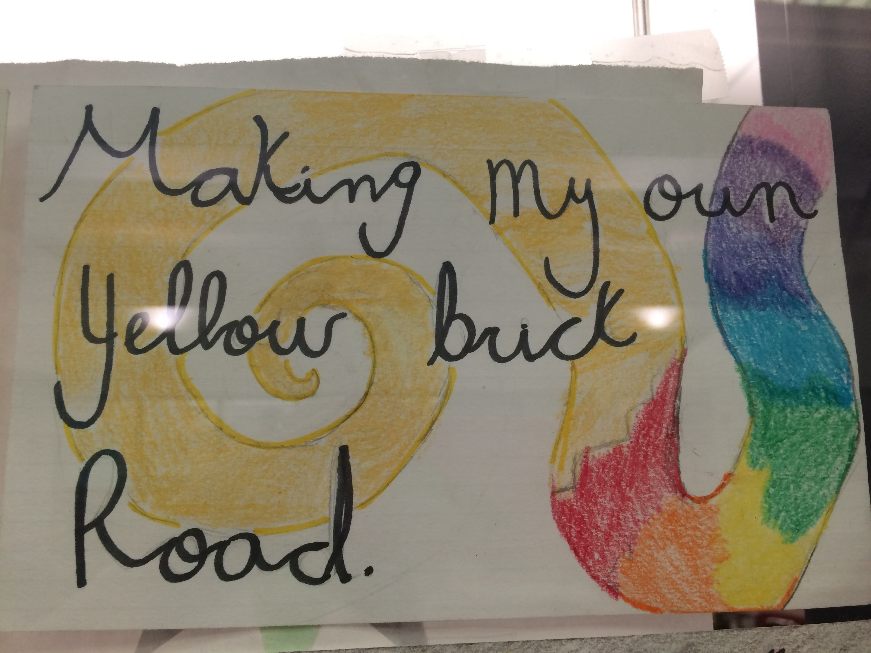

Slide 22
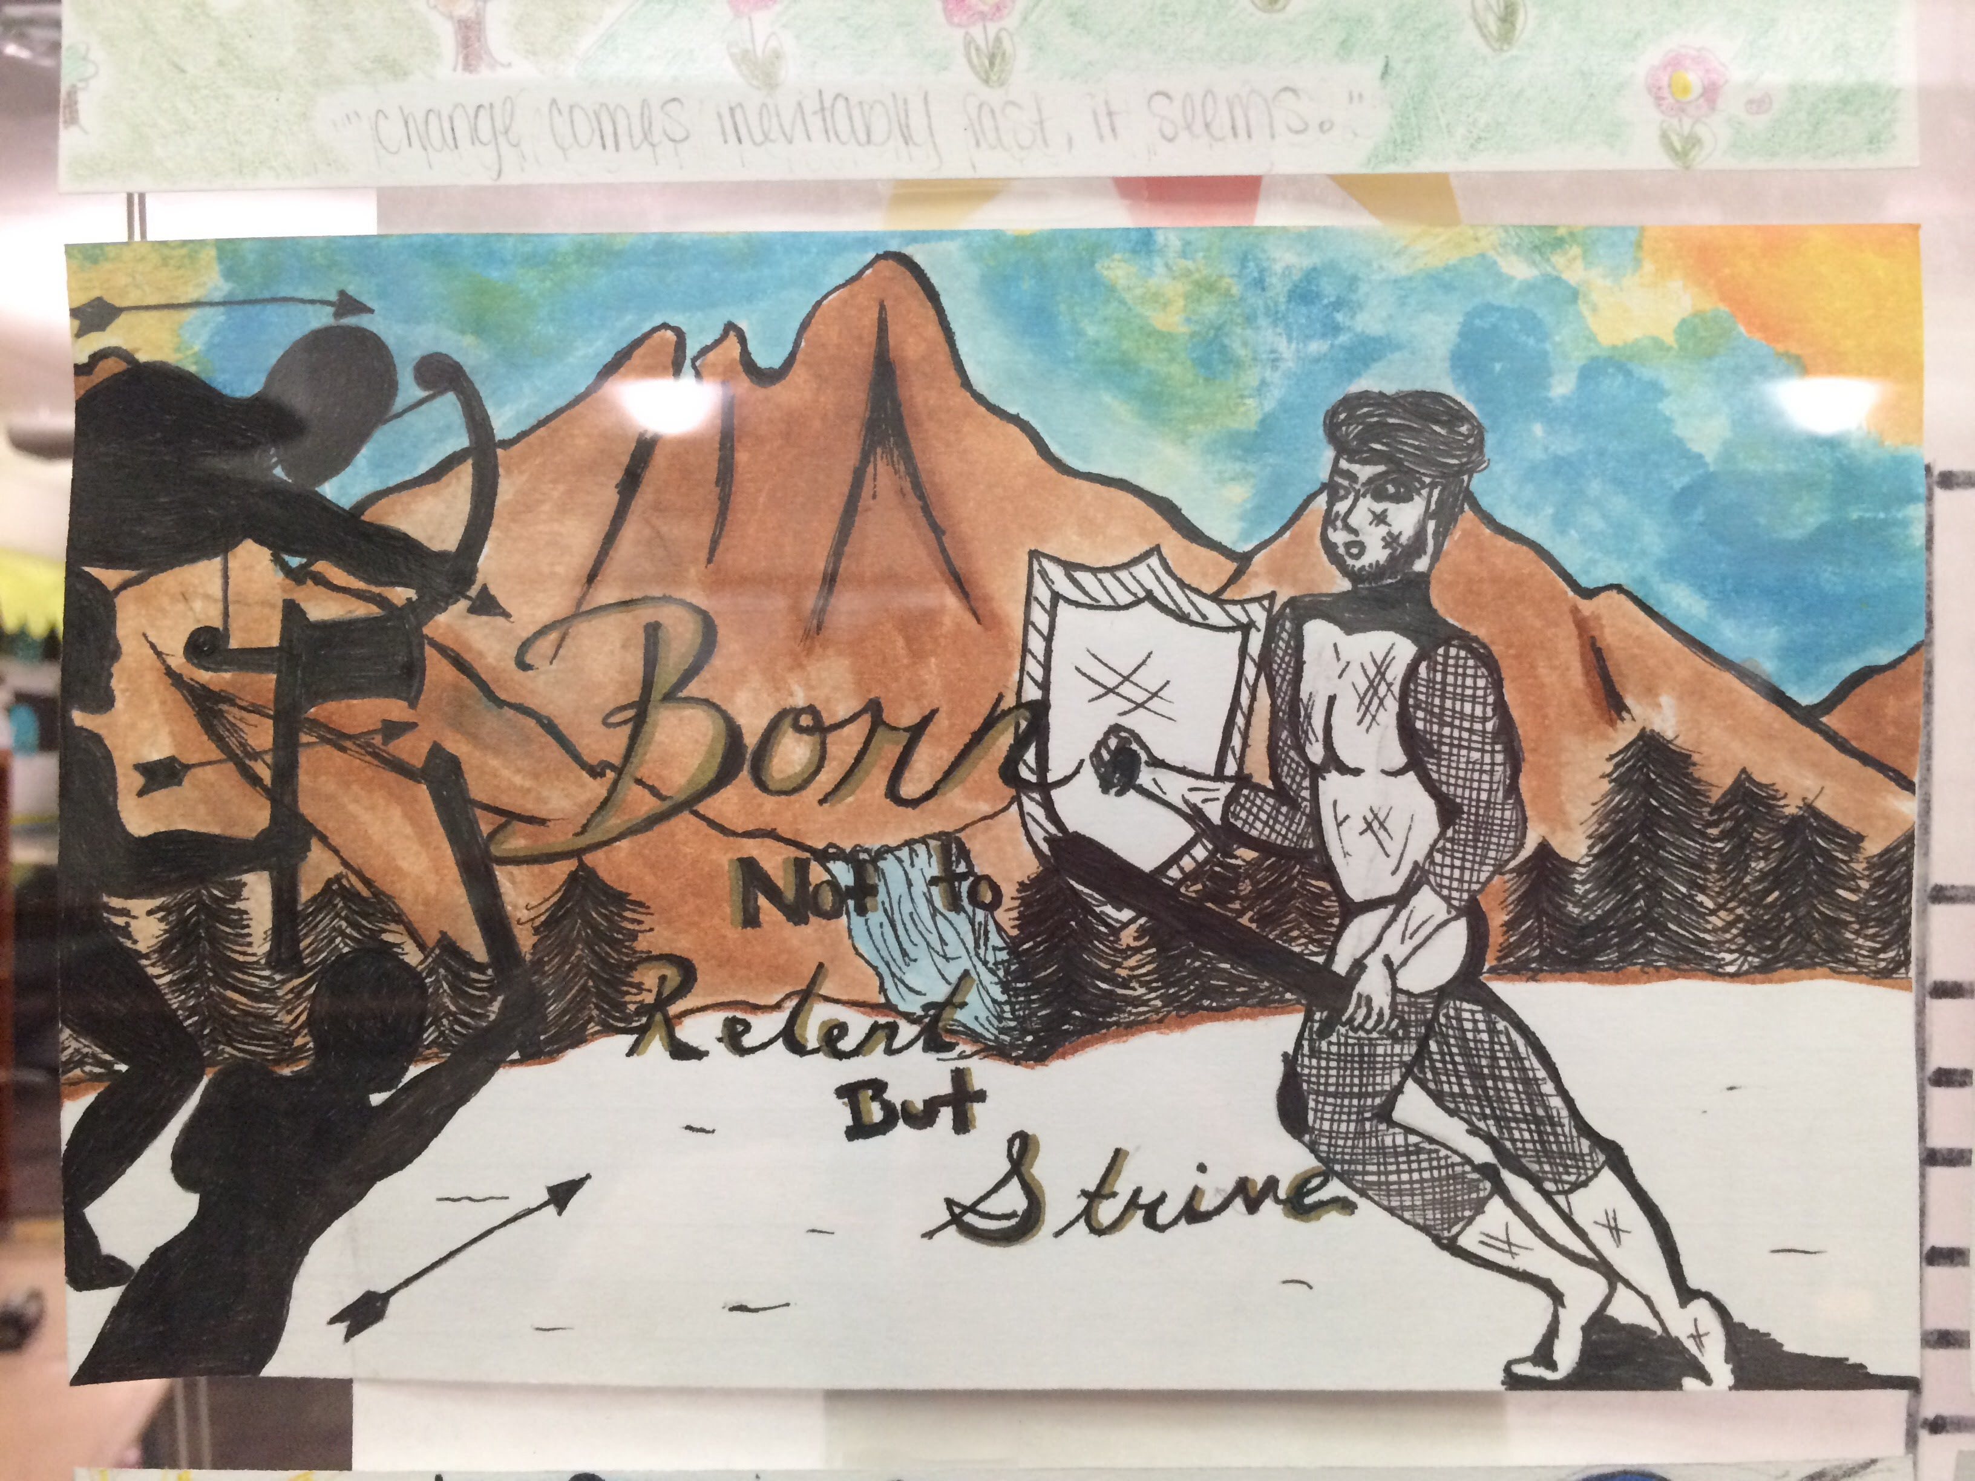

Slide 23
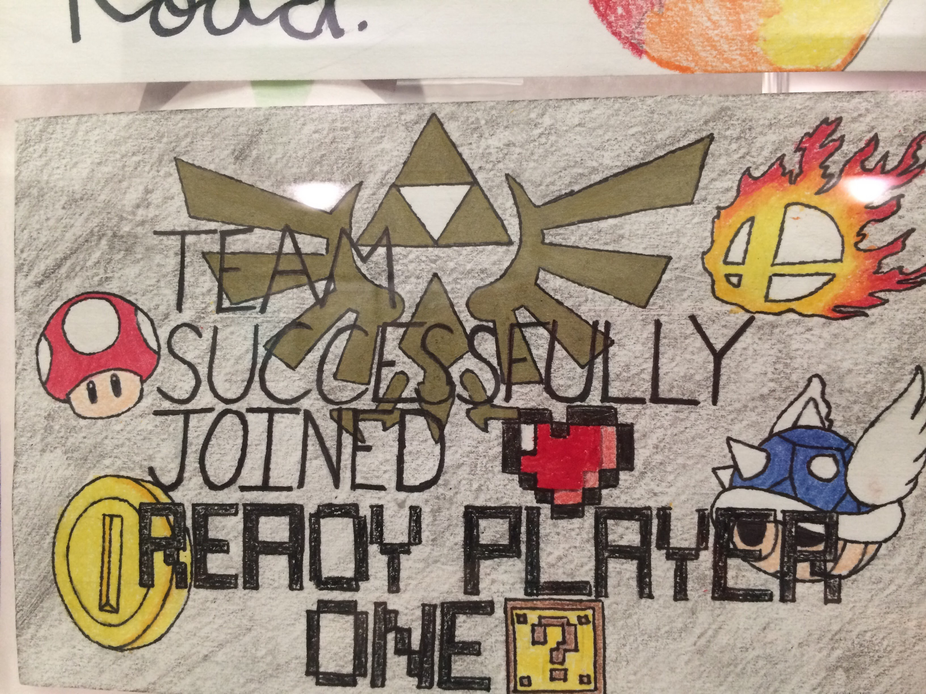

Slide 24
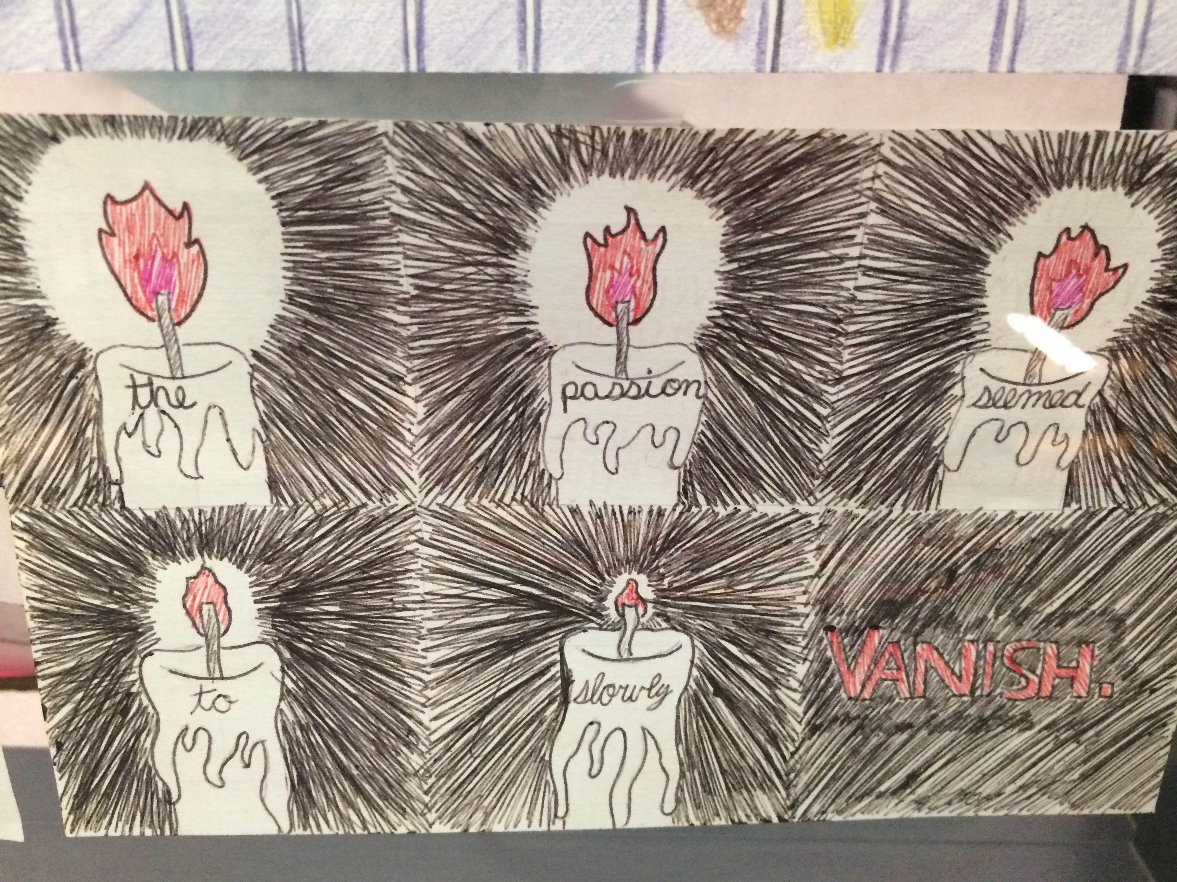

Slide 25
Question out the door: day 2
Share one of your six word memoirs.

Slide 26
Six word memoirs/The power of words day 3:
Step 1: Choose your favorite six word memoir. (Original and the one you revised for connotation and register.)
Step 2: In a brief paragraph on the back of the card, describe what you have learned about the importance of word choice in writing through the genre of the six-word memoir. What are the advantages/challenges to this type of writing.
AND… Explain how you used CONNOTATION and/or REGISTER to convey meaning in your writing.

Slide 27
Example of revised memoir and SAP.
Four cats; no plans to stop. (original) People like me don’t get PhDs. (original)
Servant to cats; life is good. (revised) Southside girl: Woman with her doctorate. (revised)
SAP:
Through writing six-word memoirs, I have learned that I can convey a deep meaning with only a few words. I must choose the precise word in order to establish tone and audience immediately. In the first example, the original focuses on the negative. The words “no plans” signifies a negative action, almost rebellious. In my revision, I focused on connotations. The revised version uses the word “servant.” The word “slave” would have been too negative and carried negative connotations. The word “servant” can be a positive thing if one enjoys one’s servitude. I revised the negative into a positive at the end when I said “life is good.” This creates what writers call juxtaposition, meaning two conflicting ideas. Being a servant is typically negative, but by saying “life is good,” it is clear I enjoy my feline servitude. The register of my revised version is more formal than the first in the beginning, but ends informally by saying “life is good.” There is a juxtaposition in both register and connotation in this memoir. I learned that using connotation and register thoughtfully helps me convey meaning as a writer.

Slide 28
Question out the door
Create a six-word memoir to describe the first week of your senior year.

