Slide 1
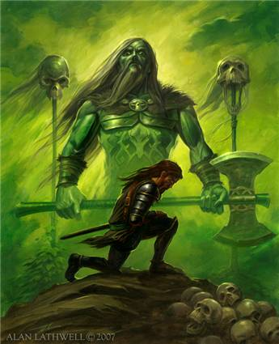
Sir Gawain and the Green Knight
Objectives:
What are the characteristics
of medieval Romance?
2. What is the chivalric code of
Honor and how does it appear in modern-day life?

Slide 2
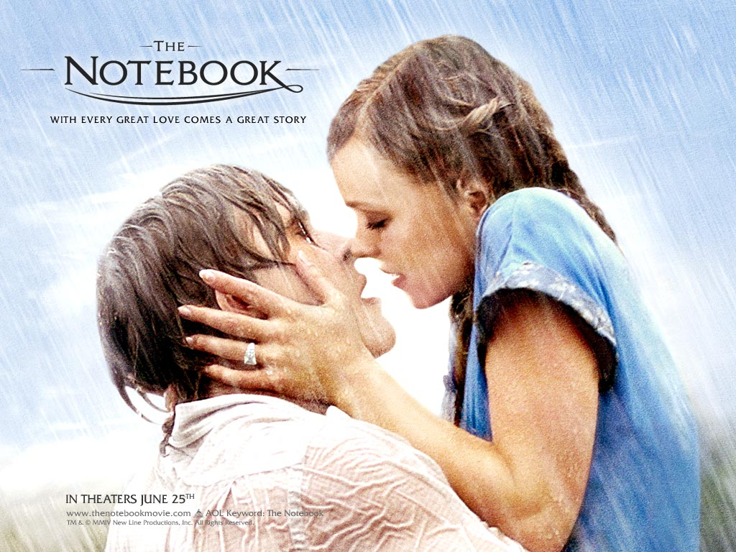
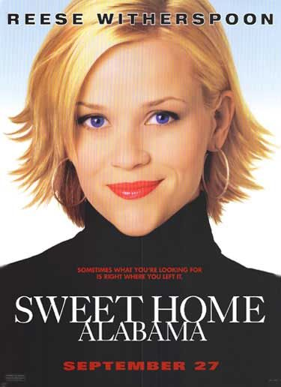
So what kind of story is this?
It’s a ROMANCE (but not like the movie The Notebook or Sweet Home Alabama).
ROMANCE:
a narrative set in a world of pure wish fulfillment
superhuman heroes fight and almost always conquer the forces of evil
the hero undertakes a hard journey in search of something valuable (a quest…remember that?)

Slide 3
Medieval Romance
Author unknown (he was known as the Pearl Poet)
Poem was written in the second half of the 14th century
The poem was found in a manuscript from around 1400 with several other poems, nothing is known of the manuscript’s author.
The poet was well-educated.

Slide 4
Medieval Romance: a verse or prose narrative that usually involves adventurous heroes, idealized love, exotic places, and supernatural events.
Characteristics of Romance (literature):
Idealized or larger than life characters
A hero motivated by love, faith, honor, or adventurousness
Exotic settings and supernatural or magical elements
Hidden or mistaken identity

Slide 5
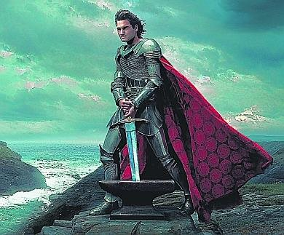
Main Characters…
King Arthur (ever heard of him?):
Legendary king of Britain
Husband of Guinevere
Uncle of Gawain
Over the famous Knights of the Round Table at Camelot
Brave, courageous, chivalrous

Slide 6
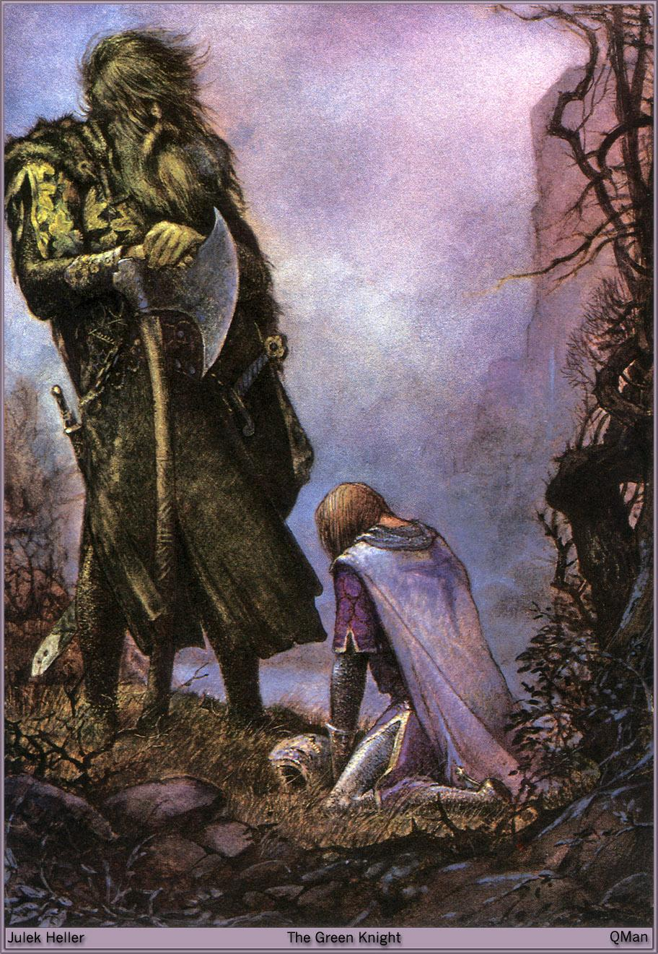
Main Characters…
Sir Gawain:
Arthur’s nephew and one of the most loyal, brave knights
Follows the chivalrous code (humility, piety, integrity, loyalty, honesty)
Courtly lover
One flaw: loves his life so much that he will lie to protect it (obviously breaking the code)

Slide 7
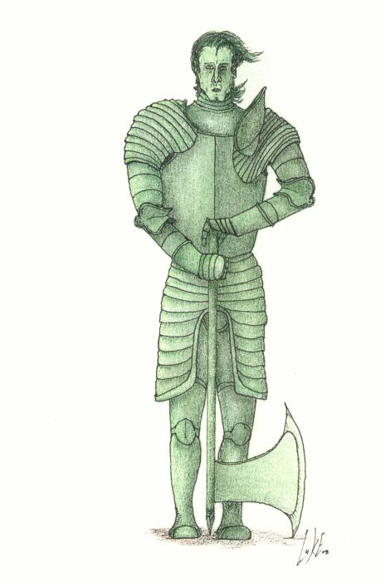
Main Characters…
The Green Knight:
Yes…he is a green man.
Huge guy with big muscles/carries a huge axe
Says he comes in friendship but proposes that someone step forward to play the “beheading game.”
Expects the knights to be courageous and step forward to play.

Slide 8
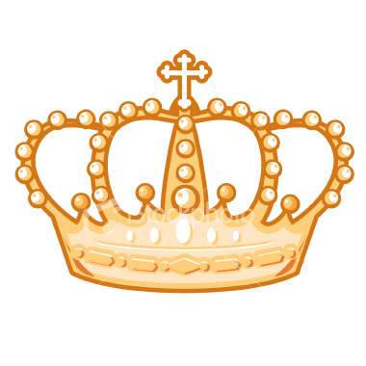
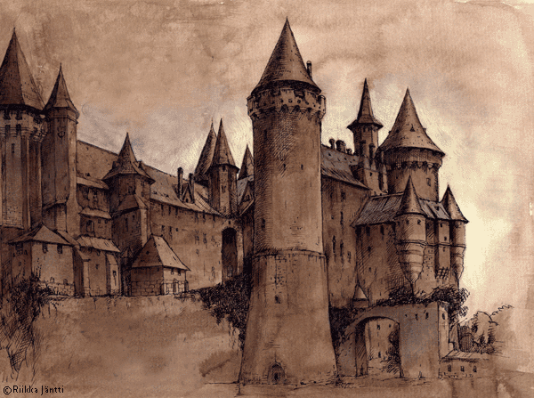
Other Characters…
Lord and Lady of the castle where Gawain stays for Christmas (The lady tries to seduce Gawain every day he is there.)
Queen Guinevere: Arthur’s wife and queen

Slide 9
Symbolism: Green
In English folklore and literature, Green has traditionally been used to symbolize nature and its embodied attributes, namely those of fertility and rebirth.
Stories of the medieval period further portray it as representing love and the base, natural desires of man (lust).
Green is also known to have signified witchcraft, devilry and evil for its association with faeries and spirits of early English folklore.
It also had an association with decay and toxicity.

Slide 10
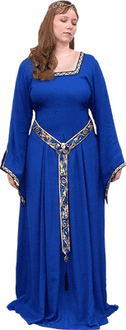
Symbolism: the Girdle
Critics who see the poem through
a Christian lens see Gawain's trust in
the girdle as a replacement for his
trust in God to save him from the
axe-wound.
A girdle in the days of the
Pearl-Poet was, “a belt worn around
the waist, used for fastening clothes
or for carrying a sword, purse, etc.”

Slide 11
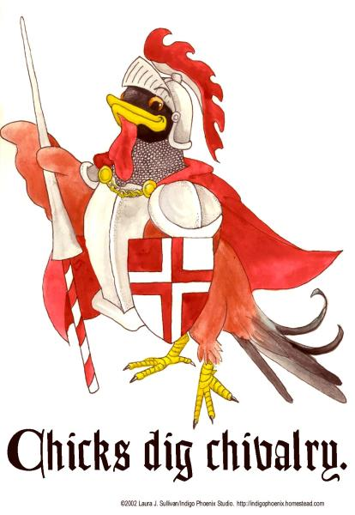
Major theme…
Chivalry:
The world of Sir Gawain and the Green Knight is governed by well-defined codes of behavior. The code of chivalry, in particular, shapes the values and actions of Sir Gawain and other characters in the poem. The ideals of chivalry come from the Christian concept of morality.

Slide 12
Themes
Hunting
Seduction
Games
Times and seasons

Slide 13
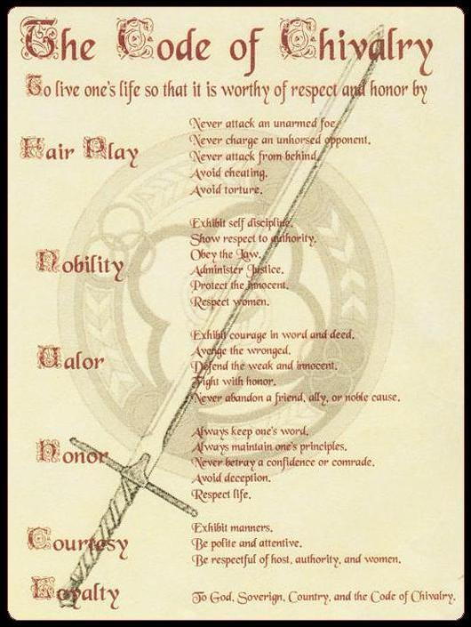

Slide 14
Feudal Pyramid

Slide 15
Major Theme…
Arthur's court depends heavily on the code of chivalry, and Sir Gawain and the Green Knight gently criticizes the fact that chivalry values appearance and symbols over truth. Arthur is introduced to us as the “most courteous of all,” indicating that people are ranked in this court according to their mastery of a certain code of behavior and good manners. When the Green Knight challenges the court, he mocks them for being so afraid of mere words, suggesting that words and appearances hold too much power over the company. The members of the court never reveal their true feelings, instead choosing to seem beautiful, courteous, and fair-spoken.

Slide 16
Major Theme…
The lesson Gawain learns as a result of the Green Knight's challenge is that, at a basic level, he is just a physical being who is concerned above all else with his own life. Chivalry provides a valuable set of ideals toward which to strive, but a person must above all remain conscious of his or her own mortality and weakness. Gawain's faults throughout this story teach him that though he may be the most chivalrous knight in the land, he is nevertheless human and capable of error.

Slide 17
Setting up the story…
During a New Year's Eve feast at King Arthur's court, a strange figure, referred to only as the Green Knight, pays the court an unexpected visit. He challenges the group's leader or any other brave representative to a game. The Green Knight says that he will allow whomever accepts the challenge to strike him with his own axe, on the condition that the challenger find him in exactly one year to receive a blow in return.

Slide 18
Setting up the story…
Stunned, Arthur hesitates to respond, but when the Green Knight mocks Arthur's silence, the king steps forward to take the challenge. As soon as Arthur grips the Green Knight's axe, Sir Gawain leaps up and asks to take the challenge himself. He takes hold of the axe and, in one deadly blow, cuts off the knight's head. To the amazement of the court, the now-headless Green Knight picks up his severed head. Before riding away, the head reiterates the terms of the pact, reminding the young Gawain to seek him in a year and a day at the Green Chapel. After the Green Knight leaves, the company goes back to its festival, but Gawain is uneasy……..and away we go from there!

