Slide 1
Agenda
Bell Work
Ireland – What about it? Social - Economical situation in the 17th-18th Century.
Jonathan Swift – Biography
What is “A Modest Proposal”
Modern Version – Can we use it today?

Slide 2
Bell Work - Notable Quote
“I hate and detest that animal called man.”
Jonathan Swift
Copy the quote and decide what tone you think you might encounter in Jonathan Swift’s essay?

Slide 3
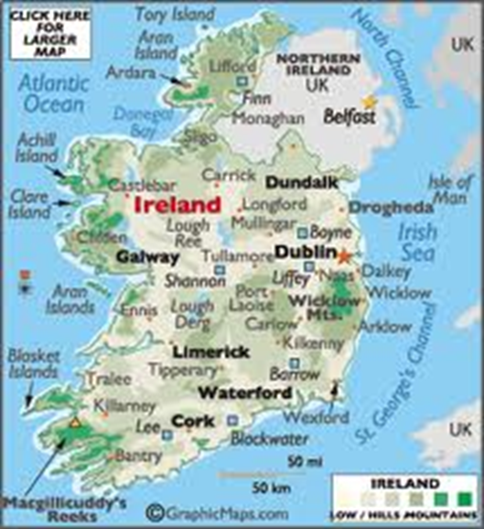
IRELAND
http://www.youtube.com/watch?v=MR5x9XMcl0o&playnext=1&list=PLA1E072A65A79F7CD&feature=results_video
http://www.youtube.com/watch?v=nDPaLRD-04s&playnext=1&list=PLA1E072A65A79F7CD&feature=results_main
http://www.youtube.com/watch?v=rRsPG-Wghxw

Slide 4
Jonathan Swift
1667–1745
https://www.youtube.com/watch?v=wdlnSQ36uxE

Slide 5
What is “A Modest Proposal?”
http://www.youtube.com/watch?v=Pxgb0O33sbU

Slide 6
Read the Handout
Read independently: “Simply a modest proposal: Open season on children in Arizona.” Jot down your thoughts in your notebook.
What is your opinion?
Do you feel offended?
What might be offensive to our society?
Share with your group or partner and come to a consensus.
Share with the class.

Slide 7
Follow up Rap
http://www.youtube.com/watch?v=Yf0LH8FtHAc

