Slide 1
“Seeing Beyond Our Own World: Using Character Point-of-View Activities to Introduce Students to Critical Theory”

Slide 2
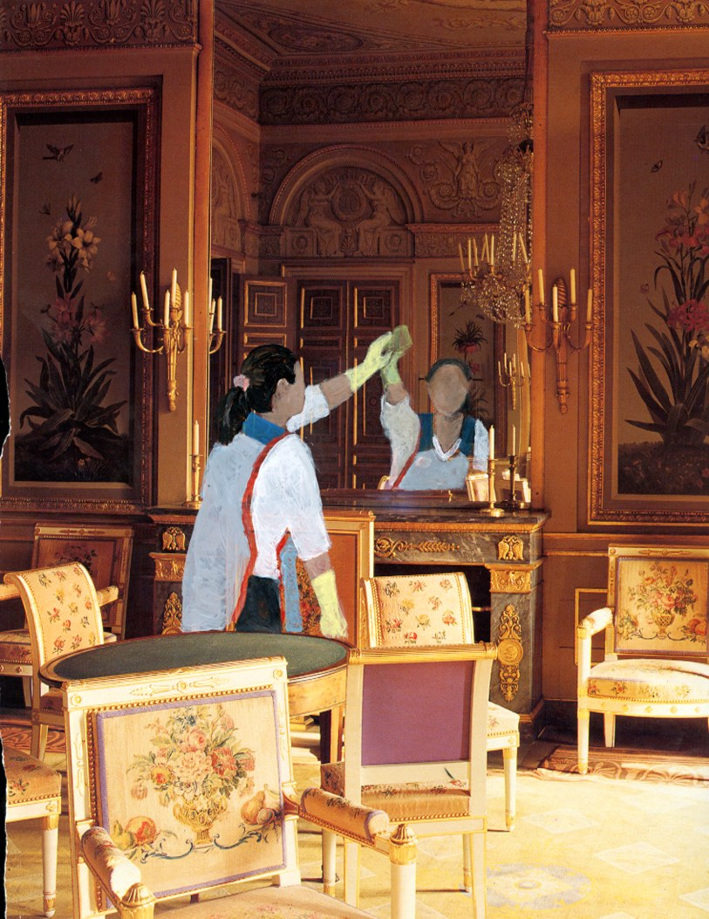
"Miriam’s Reflection
(The New Gilded Age)”
Respond to this image. What do you see? What comes to mind? What does it remind you of?

Slide 3
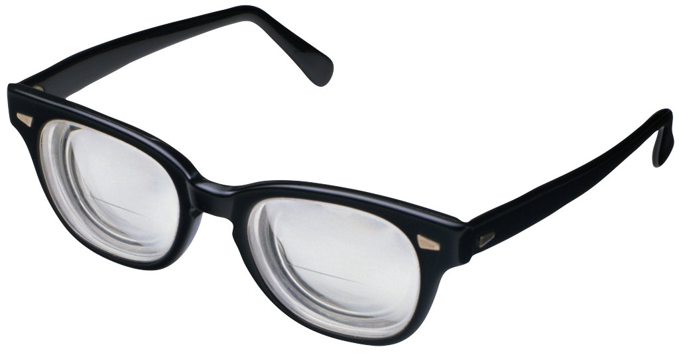
Why Critical Theory, Literary Criticism?
Critical Theory: theories about the ways we see the world. Tries to explain the values and assumptions that underlie the ways we see the world (and therefore the ways we read and interpret literature).
“Critical theory can help us learn to see ourselves and our world in valuable new ways, ways that can influence how we educate our children, both as parents and teachers; how we view television, from the nightly news to situational comedies; how we behave as voters and consumers; how we react to others with whom we do not agree on social, religious, and political issues; and how we recognize and deal with our own motives, fears, and desires” (p. 2).
“Think of each theory as a new pair of eyeglasses through which certain elements of our world are brought into focus while others, of course fade into the background” (p. 3).

Slide 4
Upon Seeing some play-Doh…
Reader Response Criticism
Feminist/Gender Criticism
Marxist/Social Power Criticism
Post-Colonial Criticism
Formalist/Structuralist Criticism
Post-Colonial Criticism

Slide 5
Upon Seeing Some Play-Doh...
*Reader-Response asks… ‘What does the play-doh look like? What does it remind me of?’ (This is a lens you are likely used to using.)
*Feminist/Gender theory asks… ‘What possibilities are available to a woman who has this play-doh? To a man’ Focuses on gender power (both economic and social).
*Marxist/Social Power theory asks… ‘Who owns the play-doh?’ Focuses on socioeconomic considerations; who has the monetary power in the situation?
*Formalist/Structuralist Criticism asks… ‘What shape, diameter, etc. is the play-doh? Of what is it made? (This is the closest lens to what AP asks us to do!)
*Post Colonial Criticism asks… ‘Who does NOT own the play-doh? Who took the play-doh away from whom?’

Slide 6
“Two Graveyards” by susan Tepper
The two small graveyards lay side by side like the bodies they covered. One had fancier tombstones engraved upon that told names and dates, a floral motif, or perhaps a Grecian style urn in bas relief on its façade. Some had sweet poetic verse about the dead person. The other graveyard was the slave graveyard with its decrepit unmarked slabs, many about to fall over or already down in the unkempt grass. We went to the graveyards each time we visited the island. This place of the dead— it called to us. It took an hour to get there by public bus. The first time we went was shortly after my dad died and both our families were decomposing. We rode the bus in silence aware of each other in a way that was different. Already, too soon, we knew time was thin. That first visit I found a tombstone with my birth date, and the person had my first name. She died from yellow fever. I thought about dying from fever in a hot tropical place without air conditioning, and what that would be like. Then my husband wanted to go get ice cream cones. So we left.

Slide 7
“Two Graveyards” Today’s First goal:
Recognize multiple perspectives in this story. (i.e. read this story through different eyeglasses...)
Directions:
With a partner, use your assigned lens (gender, Marxist, Post-Colonial, Psychoanalytic,Structuralist) To respond to the text.

Slide 8
Today’s Second Goal:
Reconsider your previous reader-response to “Miriam’s Reflection (The New Gilded Age).”
Directions:
Looking back at the painting, write two questions/responses through your assigned lens.
How does applying this lens highlight different aspects of the text? What can readers learn through activities like these? How can you benefit?

Slide 9
“Natural” interpretation vs. Critical theory
“Even our ‘personal,’ ‘natural’ interpretations of literature and the world we live in – ‘unsullied’ by theory – are based on assumptions, on ways of seeing the world, that are themselves theoretical and that we don’t realize we’ve internalized” (p. 4).

